Slide 1
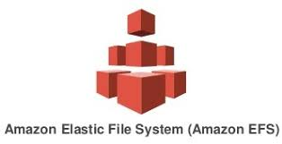
Elastic File System
Velocity Training institute
Shantanu Mahajan (sr Engg devops)

Slide 2
EFS
Amazon Elastic File System (Amazon EFS) is a simple, serverless, set-and-forget, elastic file system.
There is no minimum fee or setup charge.
You pay only for the storage you use, for read and write access to data stored in Infrequent Access storage classes, and for any provisioned throughput.
EBS is a high-performance per-instance block storage system designed to act as storage for a single EC2 instance (most of the time) EFS is a highly scalable file storage system designed to provide flexible storage for multiple EC2 instances.
You can use an EFS file system as a common data source for workloads and applications running on multiple instances.

Slide 3
advantages
EFS can be used when our application needs a shared file system, which can be accessed by multiple instances at the same time.
Reliable
Pay as you go (cost effective)
Performance that scales to support any workload.
Dynamic elasticity
Fully managed by AWS.
Security and compliance.

Slide 4
Disadvantages
No Windows instances. Amazon EFSs are not supported on AWS Windows EC2 instances. EFS volumes can only be used with non-Windows instances, such as Linux, that support NFS volumes.
No system boot volumes. Amazon EFS volumes also cannot be used for system boot volumes.

Slide 5
Use cases
Web serving and content management.
Application development and testing.
Media and entertainment.
Database backups.

Slide 6
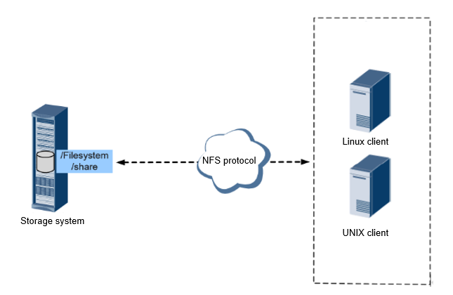
NFS
Network File System is a distributed file system protocol originally developed by Sun Microsystems in 1984, allowing a user on a client computer to access files over a computer network much like local storage is accessed.

